Slide 1
Comparing Data Mining Solution with API Solution for a Database Supplier
By
Asma Khoufi
31/08/2015

Slide 2
Plan
Introduction
Soundytics walkthrough
Data mining notions and process
Work process and specifications
Realization and Results
Conclusion and perspectives

Slide 3
Introduction

Slide 4
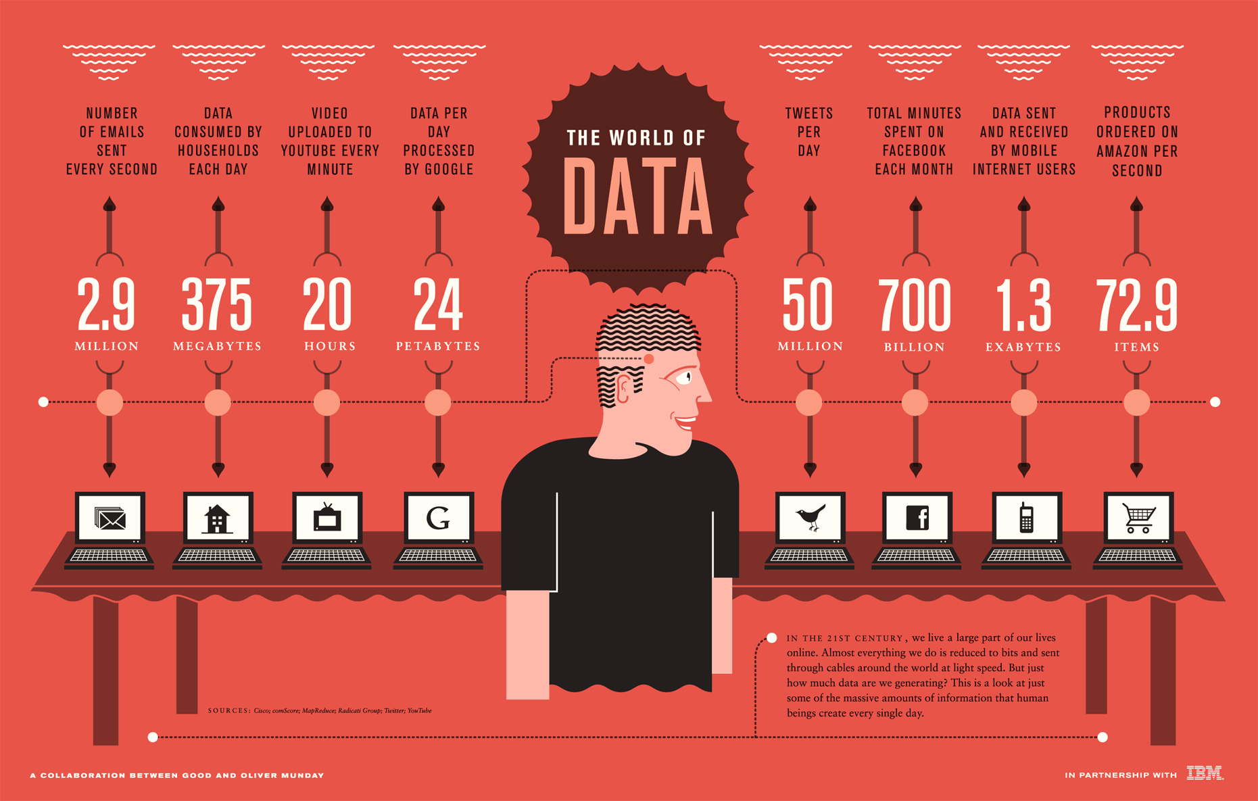

Slide 5


Slide 6
Soundytics walkthrough

Slide 7
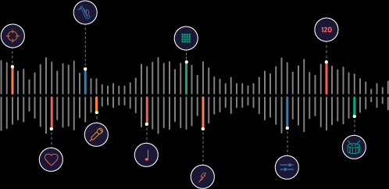
Soundytics
Services provider to music platforms
Approach distributor for shops
Extraction of musical DNA

Slide 8




Soundytics Prelude API
Provides to music services the data and services to enhance their recommendation and search systems.
Auto
tagging
Advanced search
Acoustic similarity
Themed playlist

Slide 9



Soundytics Prelude UI
Deploys a musical experience on music catalogs
Increases visibility and value their offer to professional customers
Relies on the Soundytics Prelude API
Automatic indextion
Better recommendation
Easy-to-use solution

Slide 10
Data mining notions and process

Slide 11

Data Mining
Data mining is the process of extracting and exploiting patterns in data
Data mining is the acquisition of knowledge and the ability to use it.
Document classification

Slide 12
Document Classification
D2
D1
D3
D6
D6
D4
D7
Class 1
Class 2
D?

Slide 13
Data mining process: CRISP-DM
Buisness Understanding
Data understanding
Data source
Data extraction
Data sources
Data preparation
Data representation (Bag of words, TF-IDF…)
Data transformation (cleaning, attribute selection…)
Deployment
Testing and evaluation
Model Building
Document classification
Naive Bayes classifier
One class classification
Holdout evaluation
Cross-validation…

Slide 14
Work process and specifications

Slide 15
Work Process: TRIZ
Wikidata API
LyricFind API…
Data extraction
Generic problem
Generic solution
Technical object
Inventive solution
Self-implemented extraction system
Supply editorial data

Slide 16
Functional requirements
Extracting artists information (real names, birth dates, gender, type, biography…)
Disambiguation
Extracting track language

Slide 17
Nonfunctional requirements
Efficiency
Reliability
Security
Maintainability

Slide 18
Data mining solution
Internal system
Weka system
Get artist name from DB
Clean name
Get wikipedia page content
String to word filtering
Build classifier
Learn
Analyse results
Classify
Insert into DB

Slide 19
API solution
Internal system
Wikidata API
Artist name
Search()
Items
Disambiguation
If artist or band
Get informations()
Birth date, country, gender, wikipedia urls, official website…
Insert into DB

Slide 20
Realization and Results

Slide 21




tools

Slide 22
Data mining Results: Cross-Validation

Slide 23
API results

Slide 24
Conclusion and perspectives
Interesting work field
Clean code integration
Fix and improve the disambiguation system
Recommendation

Slide 25
References
I.H.Witten, E.Frank and M.A.Hall, “Data Mining Practicle Machine Learning Tools and Techniques,” 2011.
D.L. Olson and D. Delen, "Advanced Data Mining Technique," Berlin, 2008.
Z. Hua, J. Yang, S. Coulibaly, and B. Zhang, "Integration TRIZ with problem-solving tools: a literature review from 1995 to 2006," in International Journal of Business Innovation and Research, 2006, pp. 111-128.

Slide 26
Thank you for your Attention

